Slide 1
The Calorie Guru
Team 10: Blake, Heman & Williams

Slide 2
Table of contents
01
02
03
04
05
06
OUR GOALS
PERSONAS
HOW WE ARE UNIQUE
DEMO
PROJECT MOCKUP + SITE DIAGRAM
FUTURE CONSIDERATIONS

Slide 3
Our Project’s Goals
Mission
Vision
"The Calorie Guru aims to empower individuals with knowledge about their dietary choices, providing a user-friendly platform to track and analyze nutritional intake. By promoting awareness and accountability, we strive to support healthier lifestyles and foster informed decisions."
"We envision The Calorie Guru as the go-to tool for users seeking personalized and comprehensive nutrition management. Through innovative features such as recipe book integration and predictive calorie tracking, we aspire to revolutionize how people engage with their dietary habits, ultimately promoting wellness and vitality."

Slide 4
Personas
Arnold
Joe
Gabriel
College student
Bodybuilder
Cooks his own meals
College student
Your Average Joe
Takes too long on Data Structures HW
Needs to Eat More
College student
Comedian in “Sheer Idiocy”
Obese
Recommended to use a nutritional tracking app

Slide 5
What makes us unique?

Slide 6
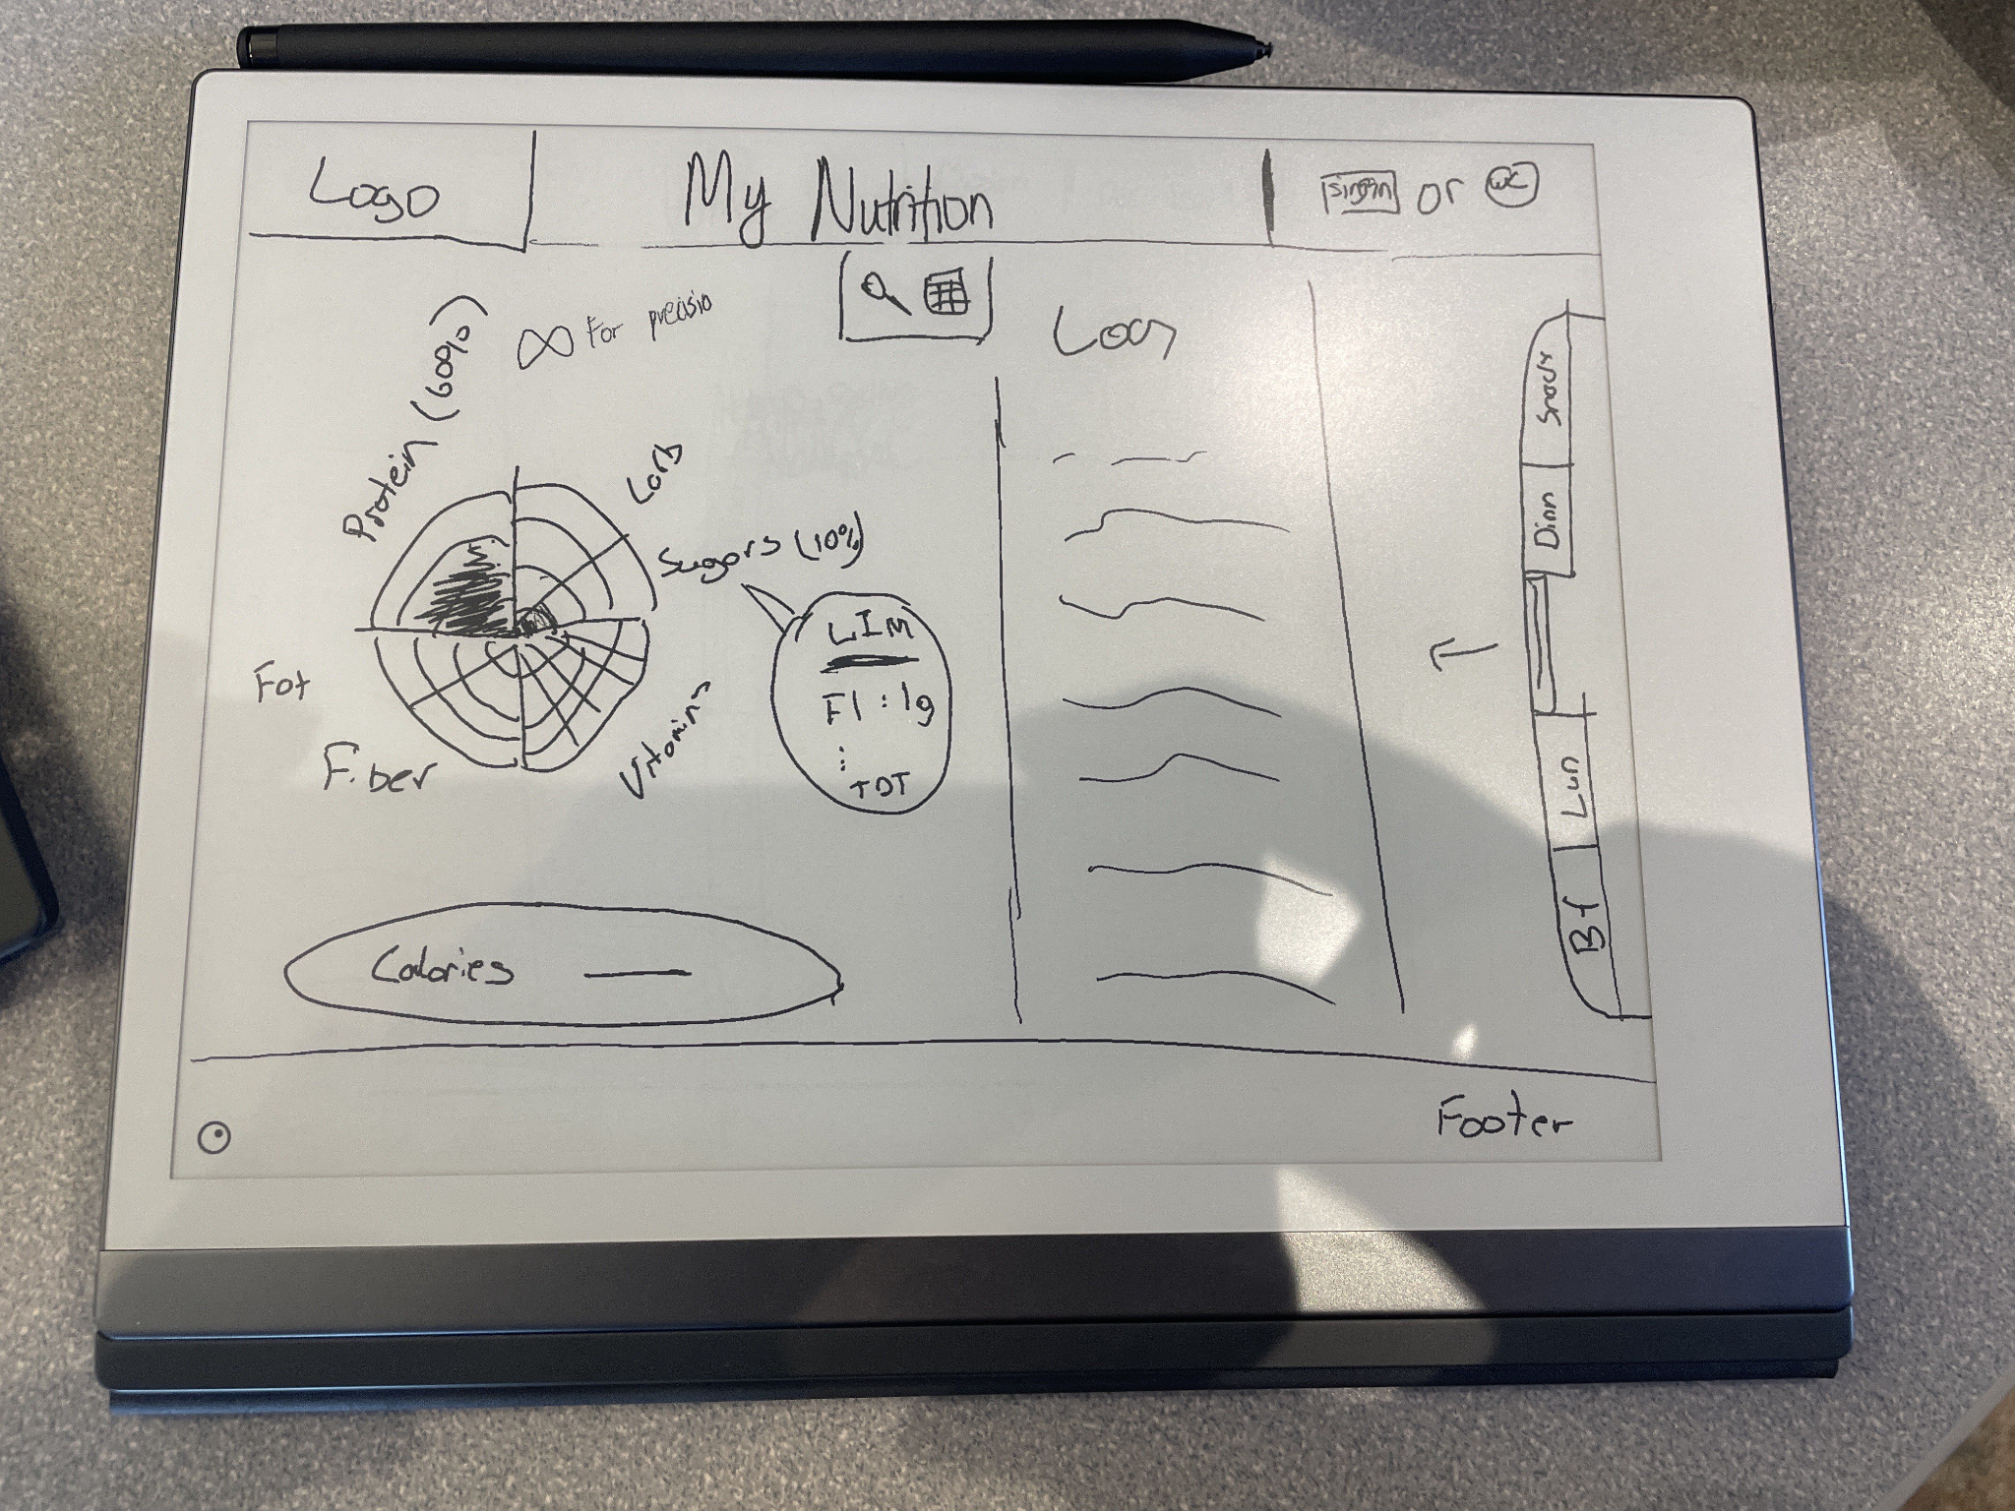
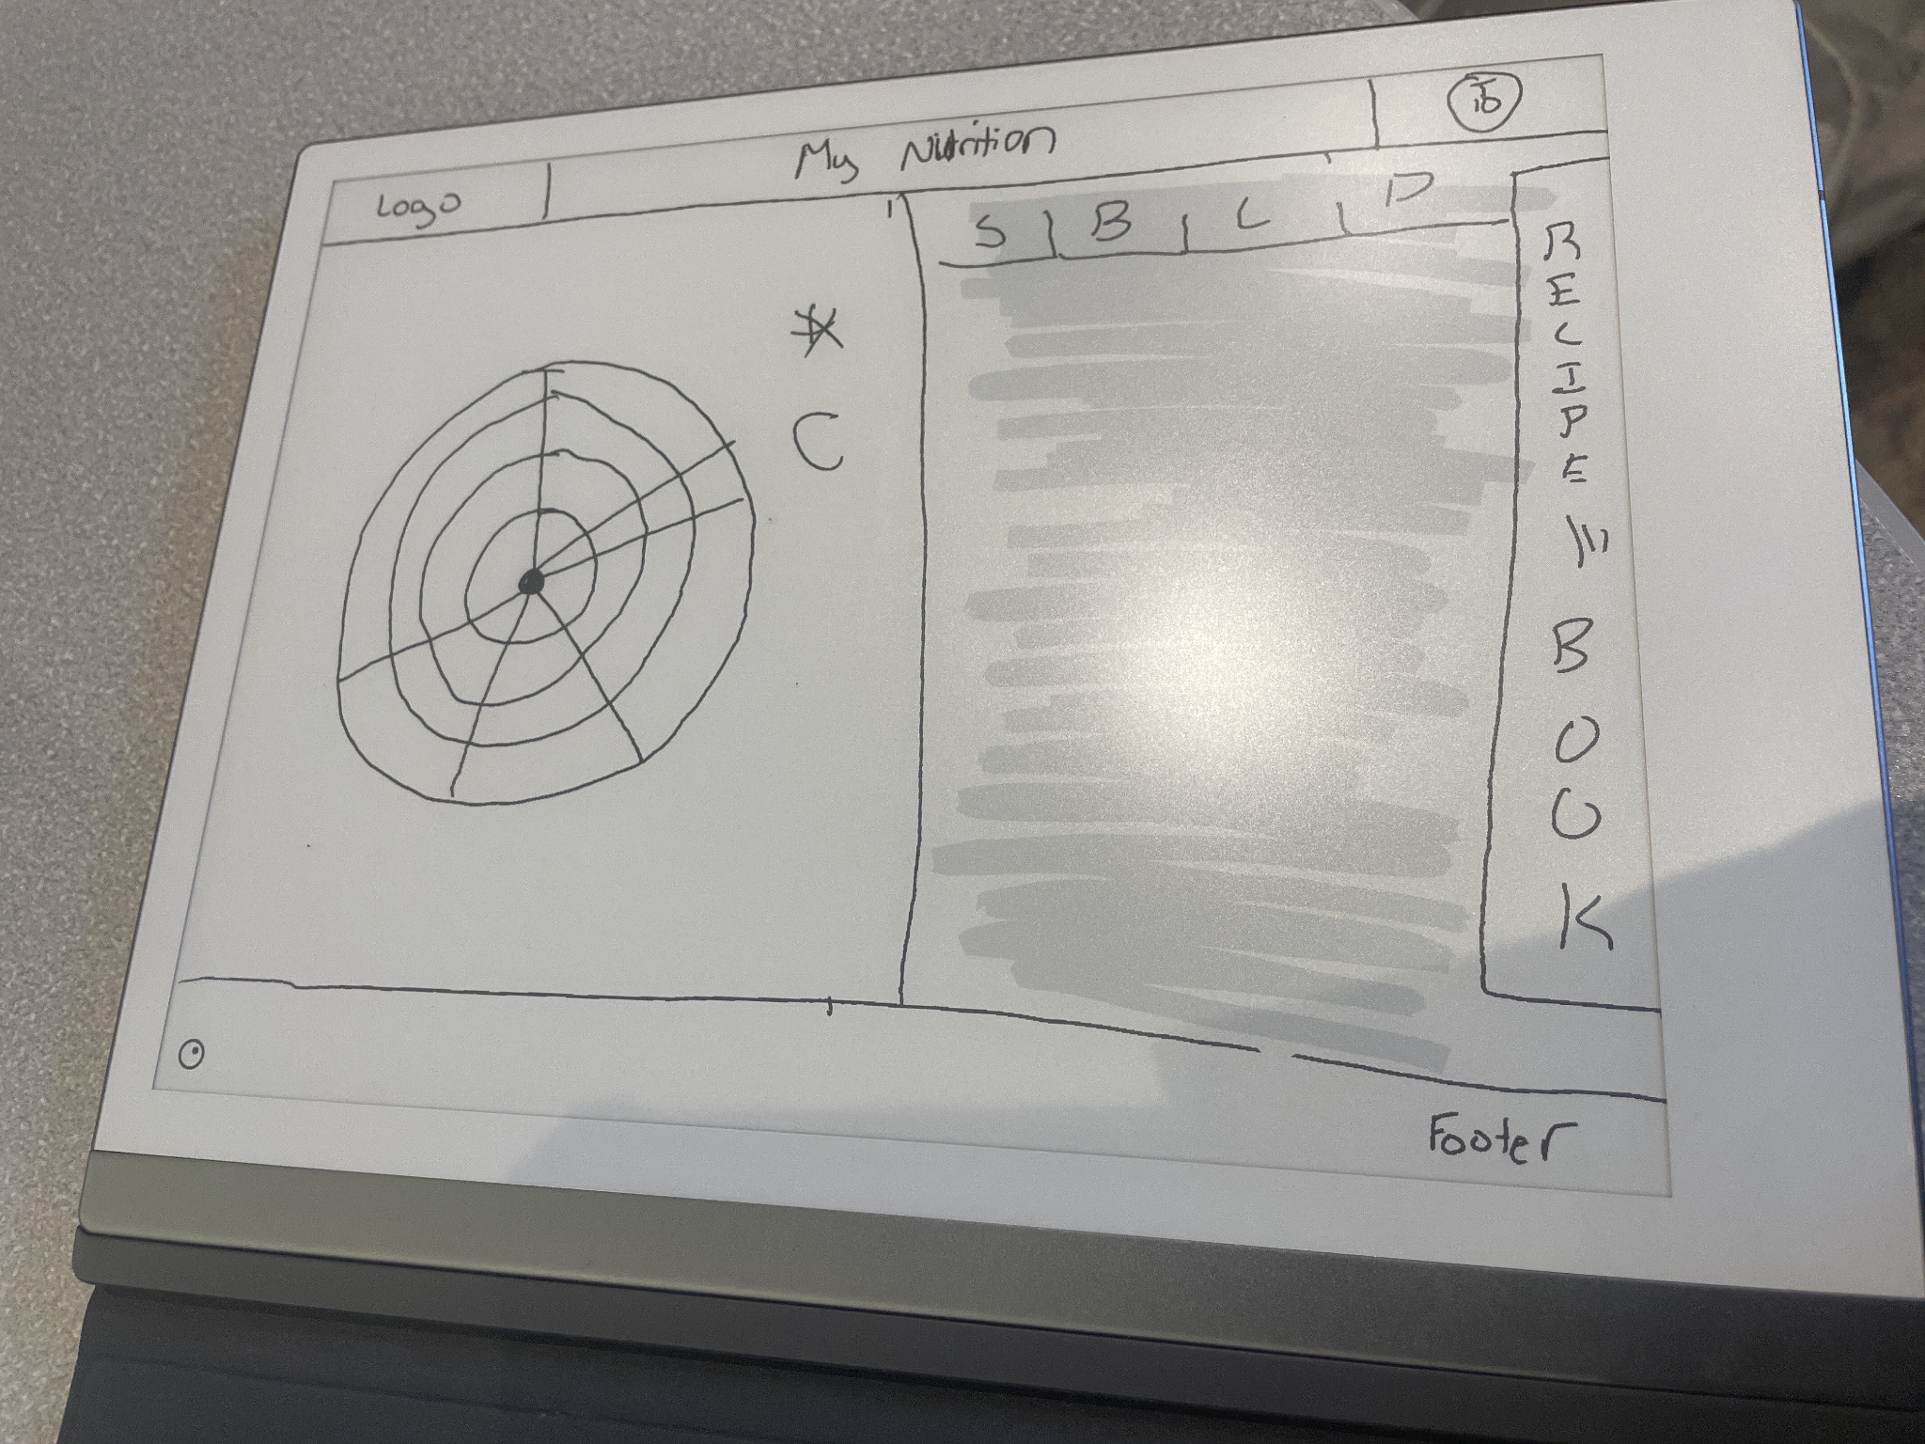
Project Mockups (Sketches & Figma)

Slide 7
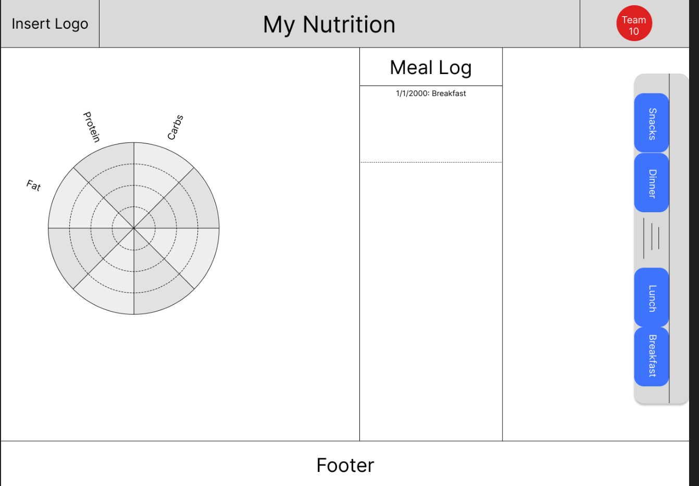
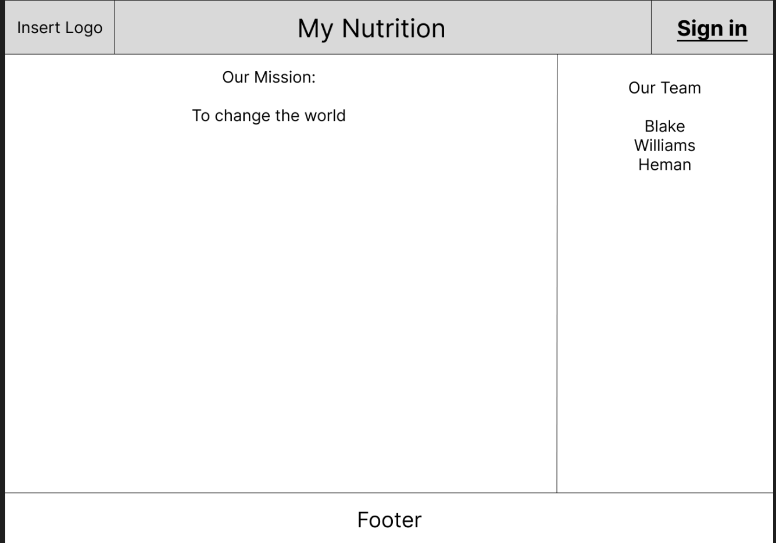
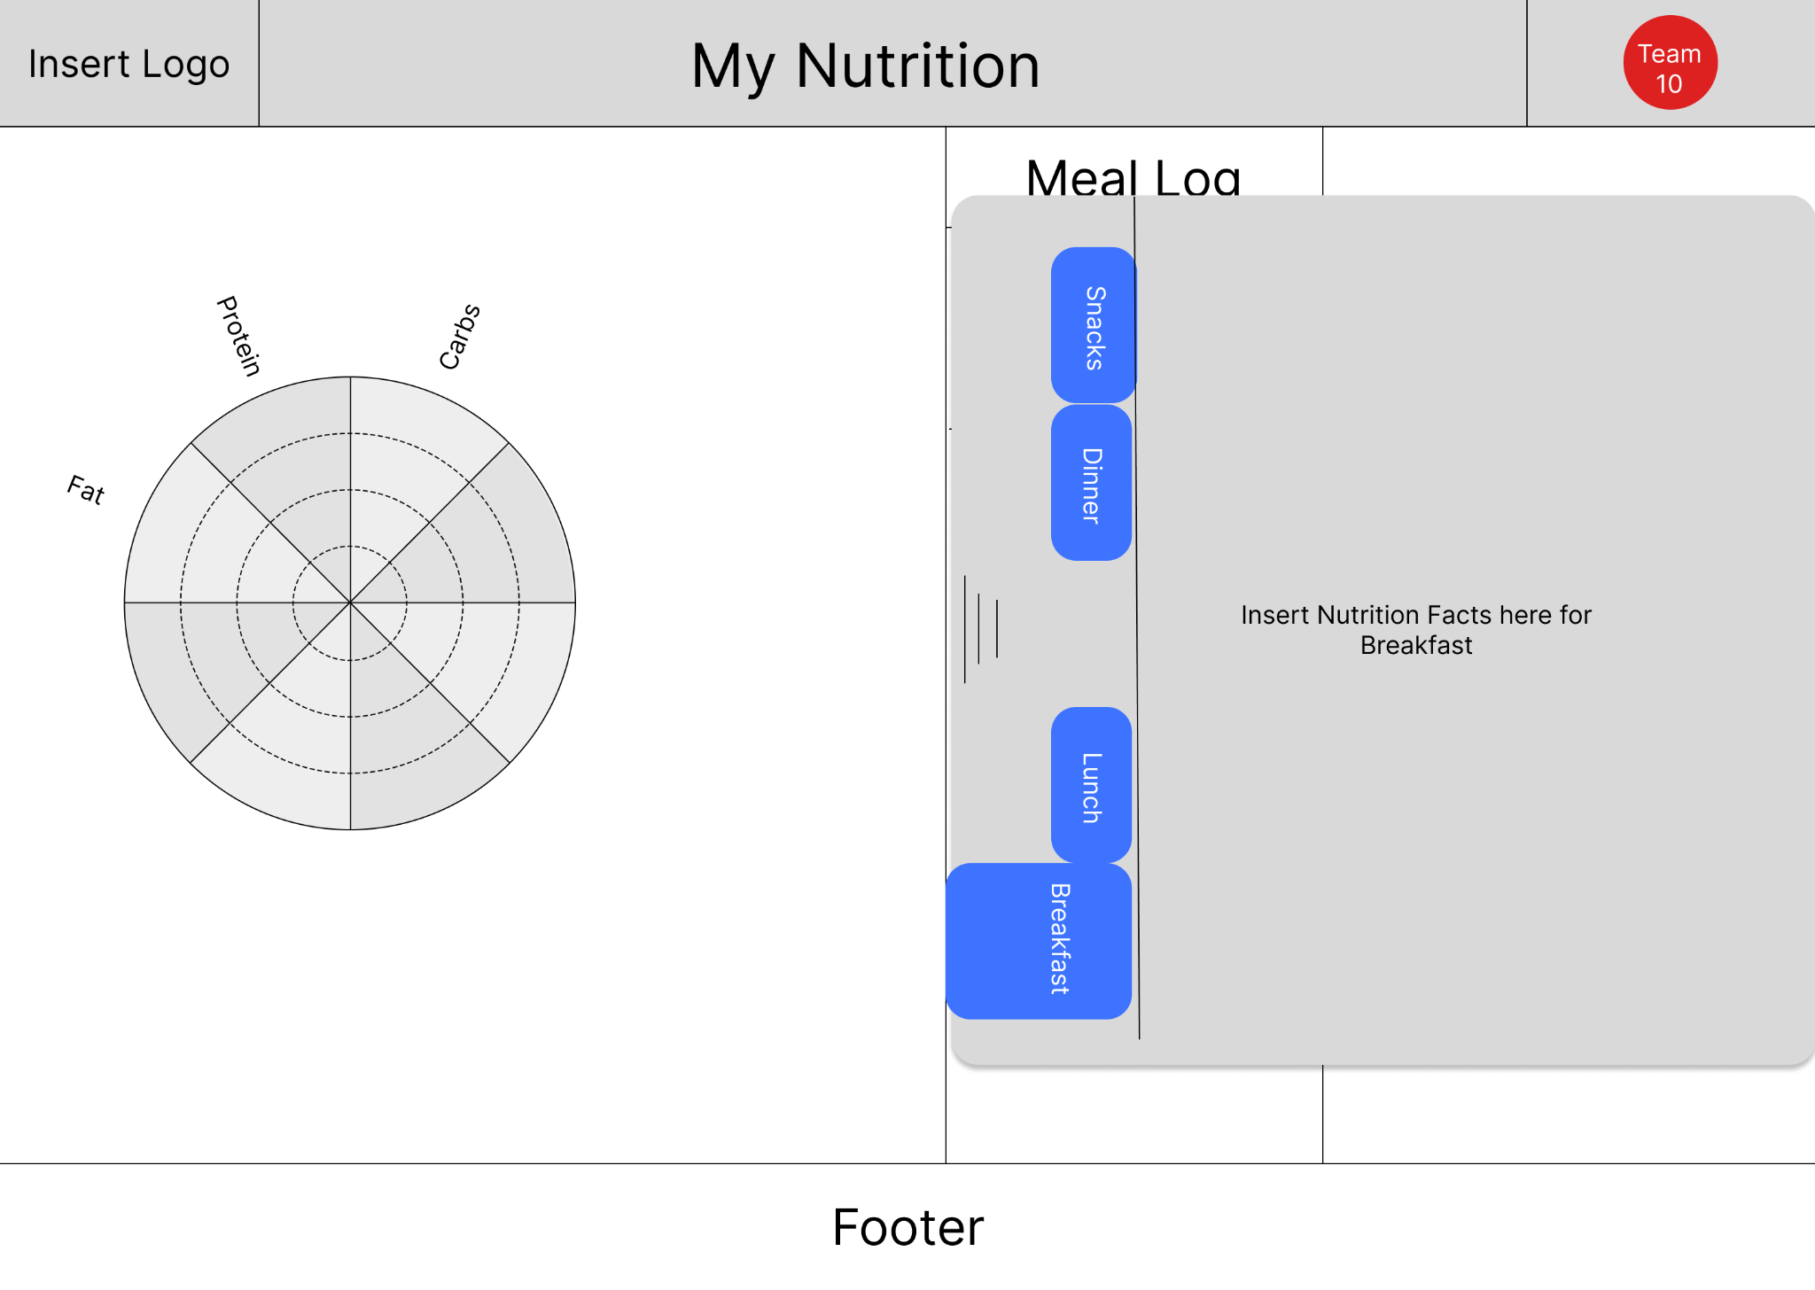
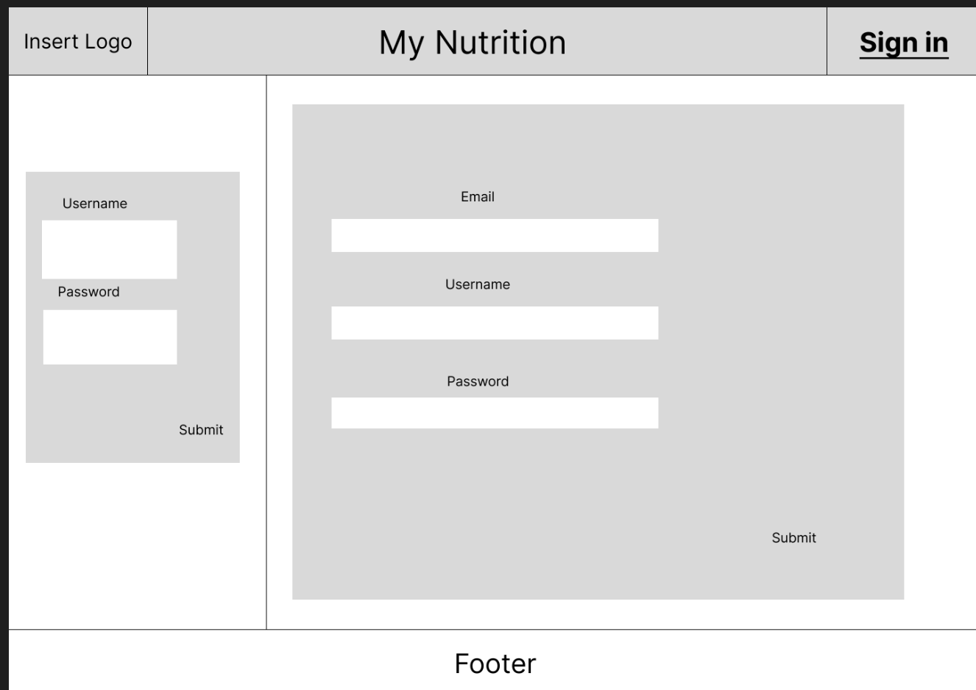

Slide 8
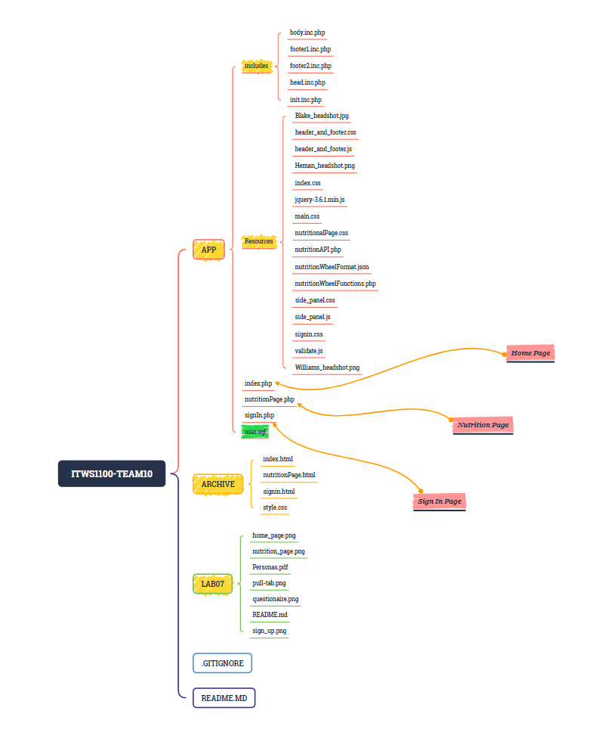
Site Diagram / IA

Slide 9
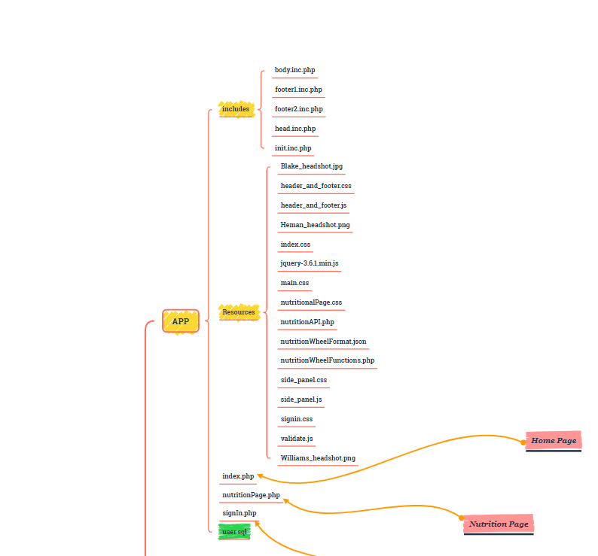
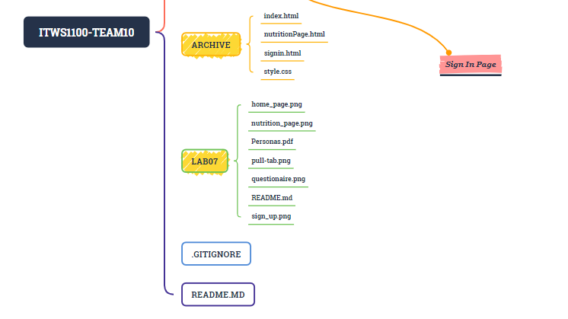

Slide 10
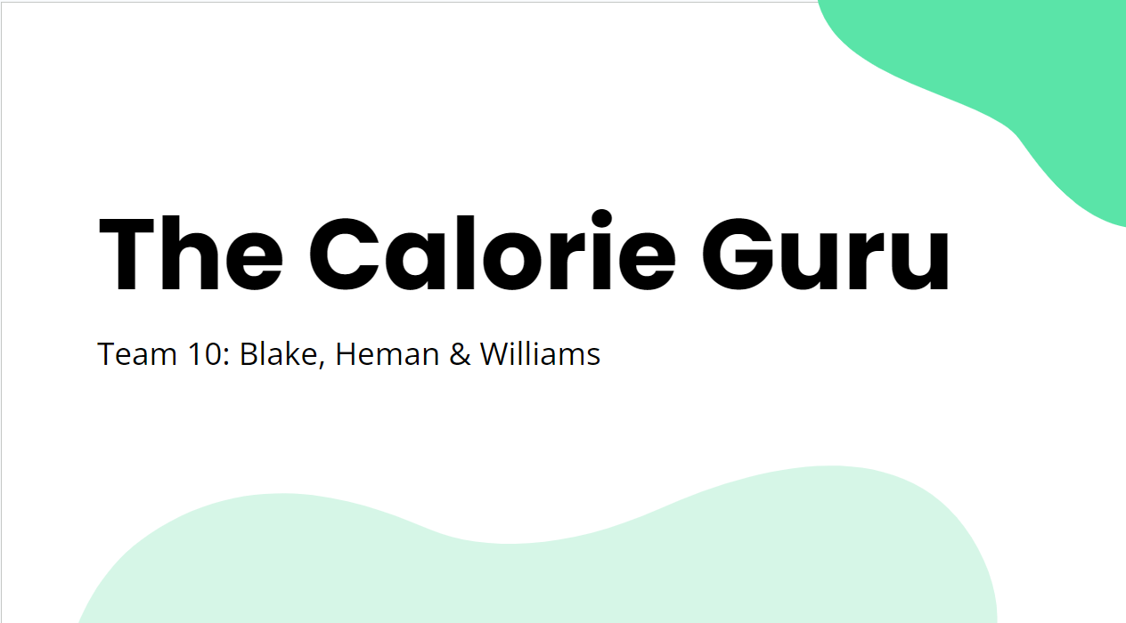
DEMO TIME!

Slide 11
Future Plans
Custom Nutrition Recommendations
Create Breakfast/Lunch/Dinner/Snacks Sections
Display by Day
Forum Section where Recipes & Meal Logs can be shared
Nutritional Label Scanner

Slide 12
Thanks!
Questions?

Slide 13


